Slide 1
Activation Functions

Slide 2
1. ReLU (Rectified Linear Unit)
f(x) = max(0, x) Outputs 0 for negative inputs, keeps positive values unchanged.
Why we use it
Fast computation: No exponentials or trigonometric functions → faster than sigmoid/tanh
Solves vanishing gradients: Doesn't saturate for positive inputs (unlike sigmoid/tanh)
Natural fit for hidden layers in deep networks (especially CNNs, RNNs)
Great for non-negative data: Perfect when your sine wave data has positive peaks

Slide 3
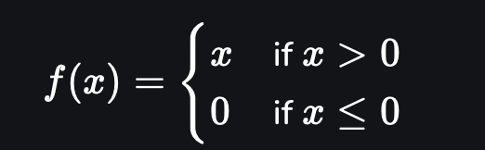
Rectified Linear Unit (ReLU) is a widely used activation function in neural networks, especially in deep learning. It is favored for its simplicity and efficiency, becoming the default choice in many neural network architectures. ReLU is a piecewise linear function that outputs the input value directly when it is positive, and outputs zero otherwise.
In simpler terms, ReLU allows positive inputs to pass through without change, while converting all negative inputs to zero. This characteristic helps neural networks avoid issues like the vanishing gradient problem, enabling them to learn complex patterns more effectively.
Mathematically, the ReLU function is defined as:
Where:
• is the input to the neuron.
• If , the function returns .
• If , the function returns .

Slide 4
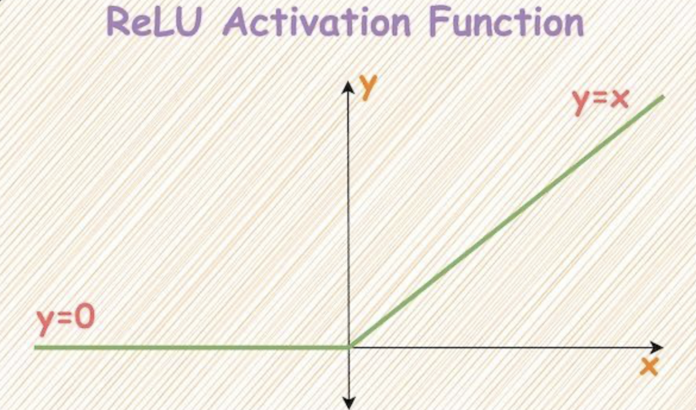

Slide 5
Python Code Example
import numpy as np
def relu(x):
"""ReLU activation: f(x) = max(0, x)
Args:
x (np.ndarray): Input data
Returns:
np.ndarray: ReLU-transformed values
"""
return np.maximum(0, x)
# Example using sine wave data
time = np.linspace(0, 2 * np.pi, 100)
sine_waves = np.sin(time) # Your basic sine wave
# Apply ReLU to the sine wave
relu_sine = relu(sine_waves)
print(f"Original sine wave min: {np.min(sine_waves):.4f}, max: {np.max(sine_waves):.4f}")
print(f"ReLU-sine wave min: {np.min(relu_sine):.4f}, max: {np.max(relu_sine):.4f}")
# Output:
# Original sine wave min: -0.9996, max: 0.9996
# ReLU-sine wave min: 0.0000, max: 0.9996

Slide 6
2. Sigmoid Activation Function
What it is
f(x) = 1 / (1 + e^{-x})
Formula : f(x) = 1 / (1 + exp(-x)) Outputs values between 0 and 1
Why we use it
Binary classification: Perfect for output layers when you need probabilities (e.g., "is this wave peak?")
Smooth gradient: Enables efficient backpropagation
Converges fast in shallow networks

Slide 7

The sigmoid function is a mathematical function that transforms any real number into a value between 0 and 1, forming an “S”-shaped curve. It is often referred to as the logistic function and is widely used in neural networks as an activation function, especially for binary classification problems.
Mathematically, the sigmoid function is defined as:
where is the input, and is Euler’s number . The function outputs values close to 0 for very negative inputs and values close to 1 for very positive inputs, smoothly transitioning through 0.5 when .
This property makes the sigmoid function useful for converting outputs into probabilities, which is essential when modeling binary outcomes. In neural networks, it introduces non-linearity, enabling the model to capture complex patterns that linear functions cannot. Sigmoid activation functions are often applied in the output layer to represent the probability that an input belongs to a particular class.
However, despite its usefulness, the sigmoid function can suffer from the vanishing gradient problem during training, where gradients become very small for extreme values, slowing down learning in deep networks.
In summary, the sigmoid function serves as a probabilistic squashing function in neural networks with the benefits of non-linearity and probabilistic interpretation, though it has some training limitations compared to newer activation functions

Slide 8
def sigmoid(x):
"""Sigmoid activation: f(x) = 1/(1+e^{-x})
Args:
x (np.ndarray): Input data
Returns:
np.ndarray: Sigmoid-transformed values
"""
# Numerical stability fix for large inputs
return 1 / (1 + np.exp(-x)) if x > -50 else np.exp(x) / (1 + np.exp(x))
# Example with sine wave peaks
peak_candidates = np.where(sine_waves > 0.8)[0] # Find potential peaks
# Apply sigmoid to peak candidates (probability of being a true peak)
peak_probabilities = sigmoid(sine_waves[peak_candidates])
print(f"Peak probabilities: {peak_probabilities}")

Slide 9
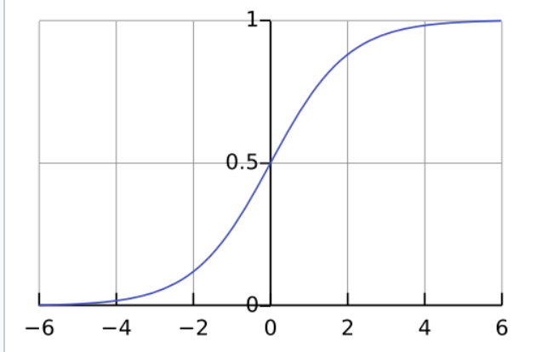

Slide 10
3. Tanh Activation Function
What it is
f(x) = (e^x - e^{-x}) / (e^x + e^{-x})
Formula : f(x) = (exp (x) - exp(-x)) / (exp(x) + exp(-x)) Outputs values between -1 and 1
Why we use it
Zero-centered output: Better for gradient flow than sigmoid
Faster convergence than sigmoid in hidden layers
Natural fit for symmetric data (like sine waves with positive/negative cycles)

Slide 11
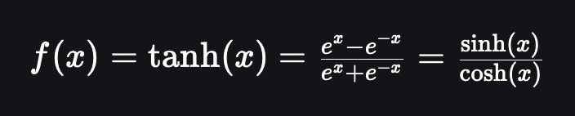
The tanh (hyperbolic tangent) activation function is a widely used mathematical function in neural networks that maps any input value to a range between -1 and 1. It is defined mathematically as:
Here, is Euler’s number, approximately 2.718, and is the input to the function. This function is similar in shape to the sigmoid but centered around zero, meaning its output values are symmetric, ranging from negative to positive, unlike sigmoid which outputs between 0 and 1.
Because its output is zero-centered, the tanh function often leads to faster convergence in training neural networks compared to sigmoid. It also helps in mitigating the vanishing gradient problem to some extent by providing stronger gradients during backpropagation. This makes tanh especially useful for hidden layers in deep networks, allowing them to model complex patterns in data more effectively.
In summary, the tanh activation function transforms inputs into a range of -1 to 1, is zero-centered, and can facilitate improved learning dynamics compared to sigmoid activation, making it a popular choice in deep learning models

Slide 12
def tanh(x):
"""Tanh activation: f(x) = (e^x - e^{-x}) / (e^x + e^{-x})
Args:
x (np.ndarray): Input data
Returns:
np.ndarray: Hyperbolic tangent values
"""
return np.tanh(x) # NumPy's optimized implementation
# Apply to full sine wave (zero-centered)
tanh_sine = tanh(sine_waves)
print(f"Tanh-sine wave min: {np.min(tanh_sine):.4f}, max: {np.max(tanh_sine):.4f}")

Slide 13
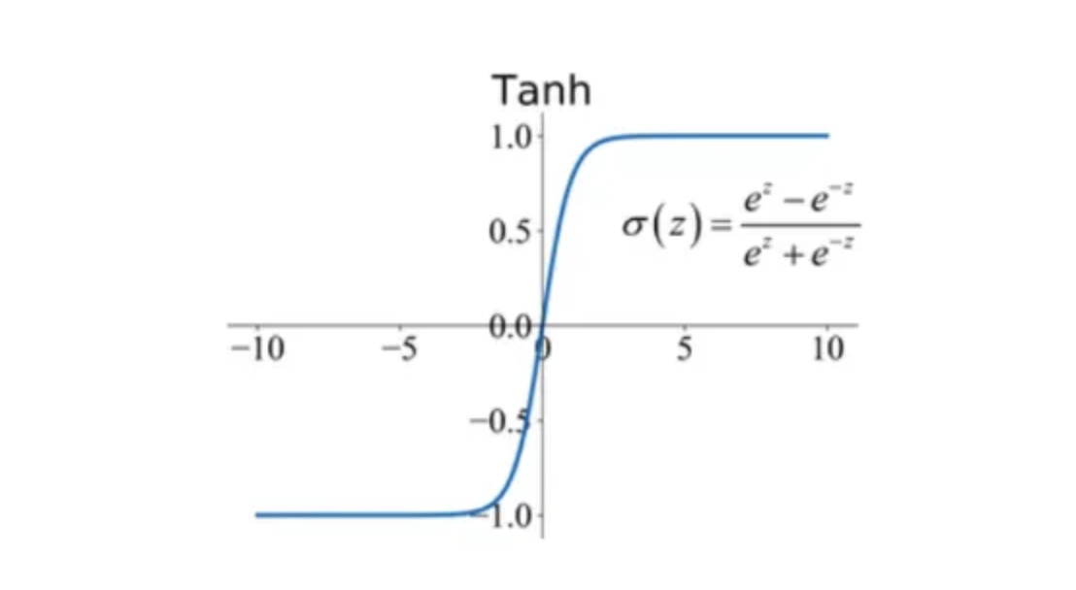

Slide 14
4. Softmax Activation Function
What it is
f_i = e^{x_i} / Σ(e^{x_j}) Converts raw scores into probabilities that sum to 1
Why we use it
Multi-class classification: Only for final output layer (e.g., "what type of wave is this?")
Probability interpretation: Each output = probability of class i
Guaranteed sum=1: Critical for multi-class predictions

Slide 15
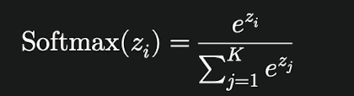
The softmax activation function is used in neural networks to convert a vector of real-valued scores (logits) into probabilities that sum to 1. This makes it particularly useful in the output layer for multiclass classification tasks, where the goal is to predict the likelihood of an input belonging to each possible class.
The function works by exponentiating each score to ensure all values are positive, then normalizing these values by dividing each exponentiated score by the sum of all exponentiated scores in the vector. Mathematically, for a vector , the softmax function for the class is defined as:
where is the number of classes, and is Euler’s number (approximately 2.718).
This transformation produces a probability distribution that is easy to interpret, where each value represents the probability of the input belonging to the corresponding class, and all probabilities add up to 1. Softmax is widely used in classification problems such as image recognition, document categorization, and speech recognition to provide probabilistic outputs that guide decision-making and model evaluation.
In summary, softmax converts raw network outputs into probabilities, enabling neural networks to perform effective and interpretable multiclass classification

Slide 16
def softmax(x):
"""Softmax activation: converts raw scores to probabilities
Args:
x (np.ndarray): Raw scores (e.g., class predictions)
Returns:
np.ndarray: Probabilities that sum to 1
"""
# Numerical stability fix: subtract max(x) to prevent overflow
exp_x = np.exp(x - np.max(x))
return exp_x / np.sum(exp_x)
# Example: Classify wave types (0=low, 1=medium, 2=high)
wave_scores = np.array([1.5, -0.3, 2.8]) # Raw scores for 3 wave types
probabilities = softmax(wave_scores)
print(f"Raw scores: {wave_scores}")
print(f"Probabilities: {probabilities}")

Slide 17
